Slide 1
Cell Division in Humans- Meiosis

Slide 2
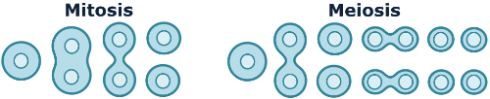
In this Smart Lesson on meiosis, you will be doing the following:
1. | Describing the process of meiosis.
2. | Explaining how meiosis is used to produce sex cells (sperm and eggs).
3. | Comparing and contrasting the processes of mitosis and meiosis.

Slide 3
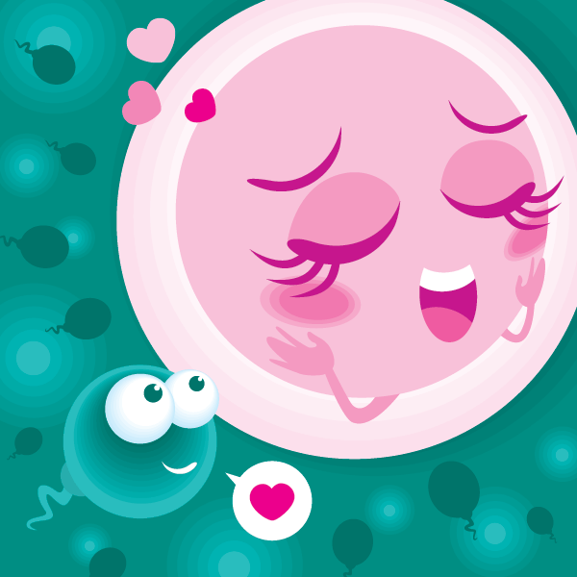
Cell division is required for reproduction.
Reproductive cells (sex cells) divide to produce sperm cells (in males) or egg cells (in females).
One sperm cell from the father and one egg cell from the mother then join together and produce a new organism that is different from both parents. This is a different type of cell division to the type used for growth and repair.

Slide 4

Sex cells (eggs or sperm) are the only cells in your body that don't undergo mitosis.
They instead undergo meiosis, another type of cell division that produces four cells with half the amount of DNA as the original cell.

Slide 5
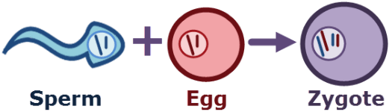
This means that an egg cell and a sperm cell can combine to form a new cell with the correct amount of DNA.
This new cell is different from both the original cells. A new organism is created!

Slide 6
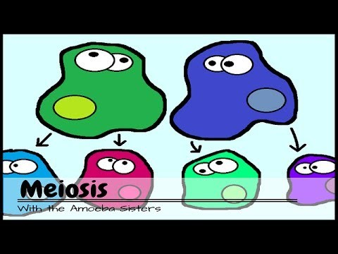

Slide 7
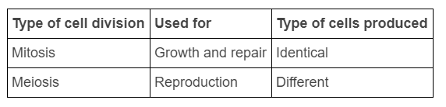

You don't need to know how the process of meiosis works, but you do need to remember that it is different from mitosis.
Here's what you need to know about these two processes:

